Slide 1
Airbnb Case Study
Presentation 2: Strategic Recommendations for Airbnb Properties in New York
Audience: Business executives. Focus on business decisions, profitability, and customer experience insights.
Team Member
Sonal Khot
Abhinandan Gupta
Amruta Patil

Slide 2
Introduction
Current Situation
Post Covid situation the restrictions are lifted people have started to travel
Revenue Decline: Recent trends have shown a significant decline in Airbnb’s revenue, prompting a need for a strategic review to address the issue.
Recovery Phase: With travel restrictions lifting and increased travel activity, there’s an opportunity to optimize Airbnb’s property and host acquisition strategies.
Competitive Landscape: The market is becoming more competitive as travel resumes, necessitating a keen focus on customer preferences and property performance.
Objectives
Identify the most valuable host types and strategic locations for acquisition to boost revenue.
Understand customer preferences in terms of neighborhoods, pricing ranges, and property types to improve property listing strategies
Develop strategies to increase traction for less popular properties and adjust existing property offerings to better meet customer needs.

Slide 3
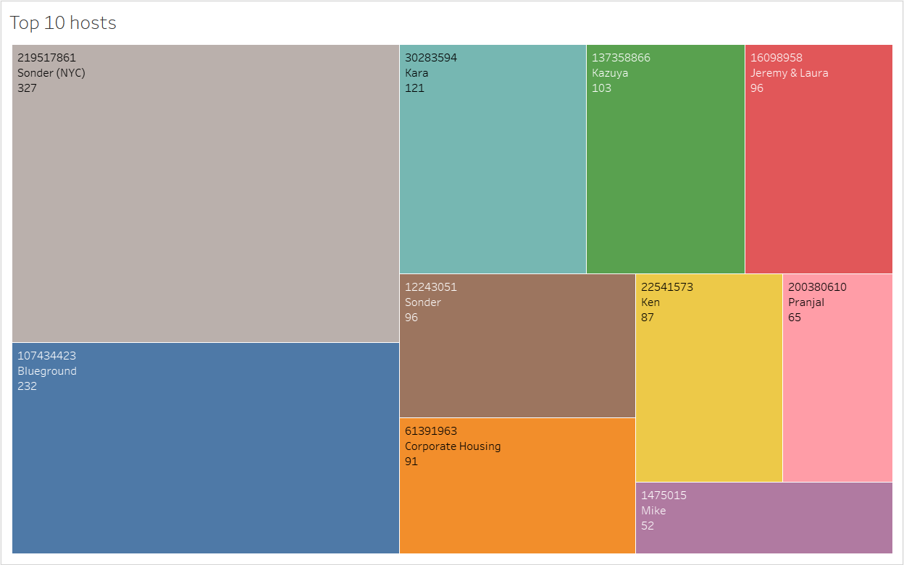
Host Acquisition Strategy
As we can see the top 10 host are given in the graph
We need to analyse in depth the characteristics to Acquire more hosts with similar profiles or high-performing hosts in underrepresented areas.

Slide 4
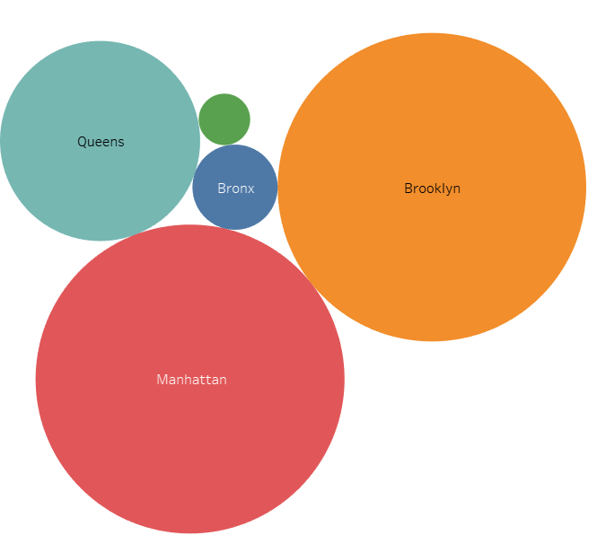
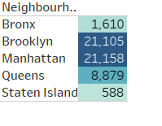
Property Insights by Neighbourhood
Looking at the data we can analyse that Manhattan and Brooklyn has been the highest demanded destination we need focus

Slide 5
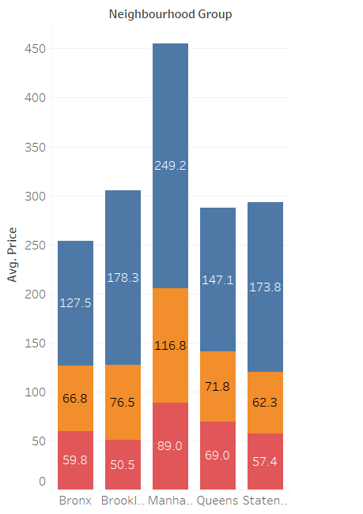
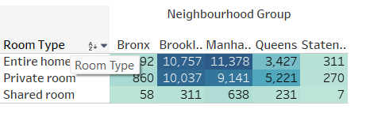
Room Type & Pricing Strategy
As we see Manhattan has higher pricing but still preferred by customer while Shared Room being cheaper are still has lower visitors
Customer prefer entire home / Apartment rather then Share rooms in Manhattan
This can help us understand that the pricing is not issue for the customer who are preferring to stay

Slide 6
Popularity of Properties
Manhattan has the most number of visitors we also see that the people reviewing these properties are also comparatively more
While the shared room are still falling behind in reviews as well
We should replicate the success of popular properties through design, amenities, etc.

Slide 7
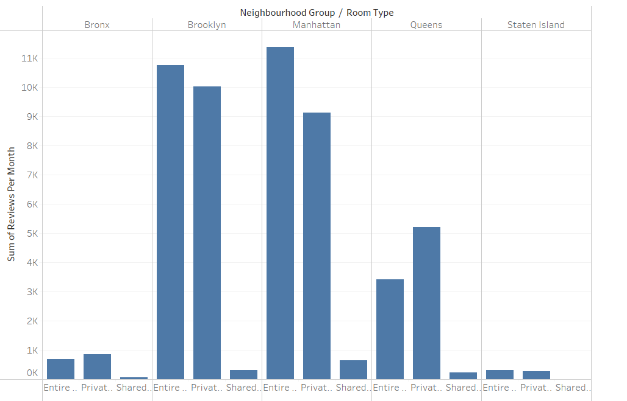
Optimizing Less Popular Properties
As we see shared room have a lesser number of ratings this may be an indication that the listing doesn’t look good or attractive
To create visibility we can add better photos, and reviews and start location-based targeting campaigns for the underperforming properties in Bronx, Queens and Staten Island

Slide 8
Conclusion
To conclude we need to replicate the working strategies from the preferred properties and use it for the neighbourhood and properties which aren’t customer favourites
Also we need to increase visibility of the low performing listing by increasing the quality of picture and reviews also we can run campaigns or provide discount to encourage the same

Slide 9
Appendix: Methodology
Insights & Visualization (Tableau )
Tools: Tableau
Steps: Imported the cleaned dataset into Tableau.
Methodology
Host Acquisition Strategy - We identified the top 10 Host Ids, Host Name with count of Host Ids using the tree map

Slide 10
Property Insights by Neighbourhood – Created a Bubble chart and text chart using neighbourhood and the count
Room Type & Pricing Strategy – In this, we used stacked bars to show the Average price for each room type which is given on the bar as per each neighbourhood also showed the Room type Majority using the highlighting tables to highlight the highest neighbourhood in room types
Popularity of Properties - We took neighbourhood in rows and sum of reviews in column and took neighbourhood groups in colour. We used filter to show Top 20 neighbours as per the sum of reviews.
Optimizing Less Popular Properties – Used a side-by-side bars to analyse the Neighbourhoods and Room type as per the sum of reviews received per month

